Slide 1



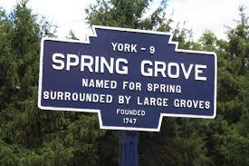

Borough of Spring Grove
Annual Public Stormwater Program Update
Prepared June 2020 by
Notes:
Cromwell (rail); Bush Street; Old Court (rail)

Slide 2
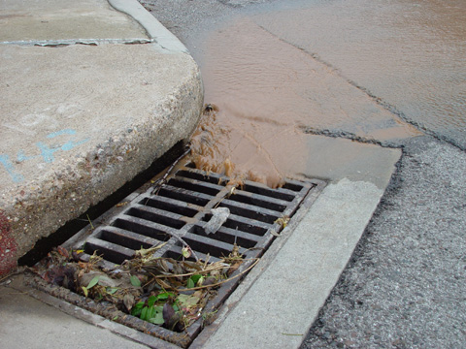
What is Stormwater?
Stormwater is rainwater or melted snow that runs off streets, lawns and other sites. When stormwater is absorbed into soil, it is filtered and ultimately replenishes aquifers or flows into streams and rivers.
In developed areas, impervious surfaces such as pavement and roofs prevent precipitation from naturally soaking into the ground. Instead, water runs rapidly into storm drains, sewer systems and drainage ditches and can cause
  Downstream flooding
  Stream bank erosion
  Increased turbidity (muddiness created by stirred up sediment) from erosion
  Habitat destruction
  Combined storm and sanitary sewer system overflows
  Infrastructure damage
  Contaminated streams, rivers and coastal water
Source: https://www.epa.gov/
greeningepa/epa-facility-stormwater-management

Slide 3
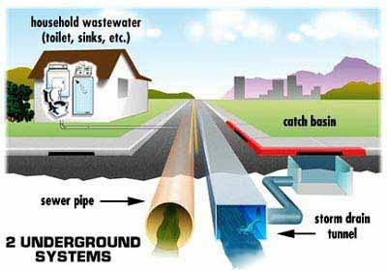
Sanitary Sewer vs. Storm
The Sanitary Sewer receives water from interior plumbing such as toilets, sinks and showers and goes to a treatment plant for processing.
The Storm Sewer receives stormwater from the street, parking lots, roofs, yards and sidewalks. This water goes DIRECTLY TO THE NEAREST STREAM, WITHOUT ANY TREATMENT.
Sanitary
Storm

Slide 4
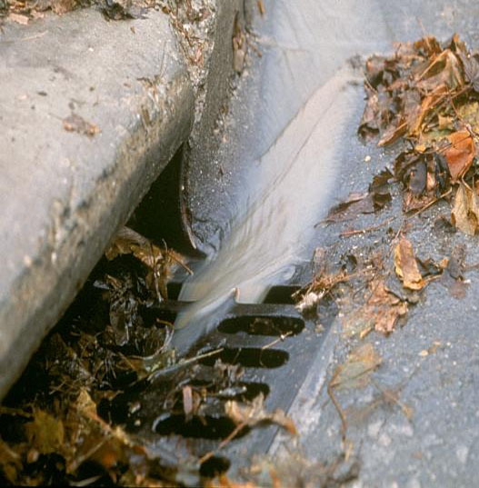
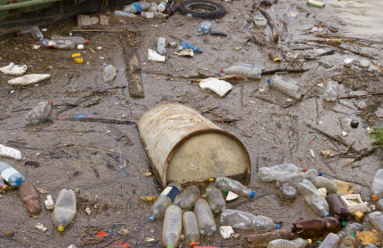
Typical Stormwater Pollutants
Petroleum
  Oil, Grease, Leaking Vehicles
Cooking greases/oils (homes, restaurants)
Sediment (soil)
Trash/garbage
Engine coolants/antifreeze (glycols)
Heavy metals from vehicle break parts and tires
Fertilizers and pesticides (residential, industrial, agriculture uses)
Fecal Bacteria
  Pet Waste, Human Waste from sewer breaks
Detergents from outdoor car washing, mop wash water dumped outdoors, etc.
Liquids from uncovered dumpsters
  printing inks, food, solutions

Slide 5
Spring Grove’s Stormwater
(MS4) Program
The EPA’s National Pollutant Discharge Elimination System (NPDES) general permit covers small municipal separate storm sewer systems (MS4s) in certain portions of the State of Pennsylvania
  For More Info - https://www.epa.gov/npdes/npdes-permit-basics
Spring Grove is categorized as an MS4 designated by the Pennsylvania Department of Environmental Protection (PA DEP) under the Clean Water Act (CWA) and associated regulations.
Spring Grove is a PAG-13 General Permit holder
MS4 owners and operators covered under this general permit must manage, implement, and enforce management programs for controlling all stormwater discharges
Link to PA DEP’s NPDES General Permit Requirements

Slide 6
Spring Grove’s Stormwater
(MS4) Program (Continued)
Except where specifically prohibited under the “Discharges Not Authorized by this General Permit” section, this General Permit authorizes the discharge of stormwater to surface waters from regulated small MS4s. In addition, the following non-stormwater discharges are authorized by this General Permit as long as such discharges do not cause or contribute to pollution as defined in Pennsylvania’s Clean Streams Law:
  1. Discharges or flows from firefighting activities.
  2. Discharges from potable water sources including water line flushing and fire hydrant flushing, if such discharges do not contain detectable concentrations of Total Residual Chlorine (TRC).
  3. Non-contaminated irrigation water, water from lawn maintenance, landscape drainage and flows from riparian habitats and wetlands.
  4. Diverted stream flows and springs.
  5. Non-contaminated pumped ground water and water from foundation and footing drains and crawl space pumps.
  6. Non-contaminated HVAC condensation and water from geothermal systems.
  7. Residential (i.e., not commercial) vehicle wash water where cleaning agents are not utilized.
  8. Non-contaminated hydrostatic test water discharges, if such discharges do not contain detectable concentrations of TRC.

Slide 7
Minimum Control Measures
(MCMs)
MCM #1- Public Outreach and Education
MCM #2 – Public Involvement and Participation
MCM#3 - Illicit Discharge Detection and Elimination (IDDE)
MCM#4 - Construction Site Stormwater Runoff Control
MCM#5 - Post Construction Stormwater Management
MCM#6 - Pollution Prevention and Good Housekeeping

Slide 8
MCM Descriptions
MCM 1
  Permittees are required to implement and maintain a public education and outreach program,and distribute education materials to the community and employees to help reduce the discharge of pollutants caused by stormwater runoff.
MCM 2
  Permittees are required to create and foster opportunities for public participation in the MS4 management program for controlling stormwater discharges. Recommended activities include adopt-a-stream programs, public surveys, storm drain stenciling, stream cleanups, tree plantings, and Earth Day events.
MCM 3
  Permittees are required to develop, implement, and enforce a program to detect and eliminate illicit discharges into the MS4 in accordance with 40 CFR § 122.34(b)(3). A permittee will satisfy this MCM by field screening outfalls, inspecting the MS4 to identify sources of illicit discharges, eliminating illegal connections or illicit discharges, and enforcing penalties where appropriate. The illicit discharge program must also address illegal dumping and spills.

Slide 9
MCM Descriptions(continued)
MCM 4
  Permittees are required to maintain an ordinance to require the implementation of E&S control BMPs, including sanctions for non-compliance, that is consistent with DEP’s 2022 Model Stormwater Management Ordinance (3800-PM-BCW0100j) by September 30, 2022. The permittee may not issue a building or other permit or final approval to those without valid NPDES permit coverage under 25 Pa. Code Chapter 102.DEP or the applicable county conservation district must be notified within 5 days of any permit applications involving an earth disturbing activity involving one acre or more, in accordance with Pa. Code § 102.42.
MCM 5
  Permittees are required to maintain an ordinance to require implementation of PCSM BMPs, including sanctions for non-compliance, that is consistent with DEP’s 2022 Model Stormwater Management Ordinance (3800-PM-BCW0100j) by September 30, 2022. Use of low impact development (LID) should be expanded and encouraged, as well as ensuring adequate O&M of all PCSM BMPs.
MCM 6
  Permittees are required to develop and implement an operation and maintenance program that includes a training component to prevent and reduce pollutant runoff from municipal operations in accordance with 40 CFR § 122.34(b)(6). A permittee will satisfy this MCM by developing, implementing, and maintaining procedures for pollution prevention and good housekeeping on permittee owned or operated properties and / or roads.

Slide 10
MCM 1 –
Education and Outreach
Annual Public Program Updates
Target Audience Groups
  Residents
  Businesses
  Borough Staff
Educational Materials, Contact Information for Complaints Regarding Water Quality and/or Illicit Discharges can be found on The Borough’s Stormwater page.
  http://springgroveborough.com/ms4/

Slide 11
MCM 2 –
Involvement and Participation
Involvement of Target Audience Groups in Stormwater related events that promote active participation and further the education of Spring Grove’s Stormwater program.
  Adopt-A-Stream
  Public Surveys
  Storm Drain Stenciling
  Rain Barrel Workshops
  Social Media Driven Events
  Stream Cleanups
  Tree Plantings
  Earth Day Events

Slide 12
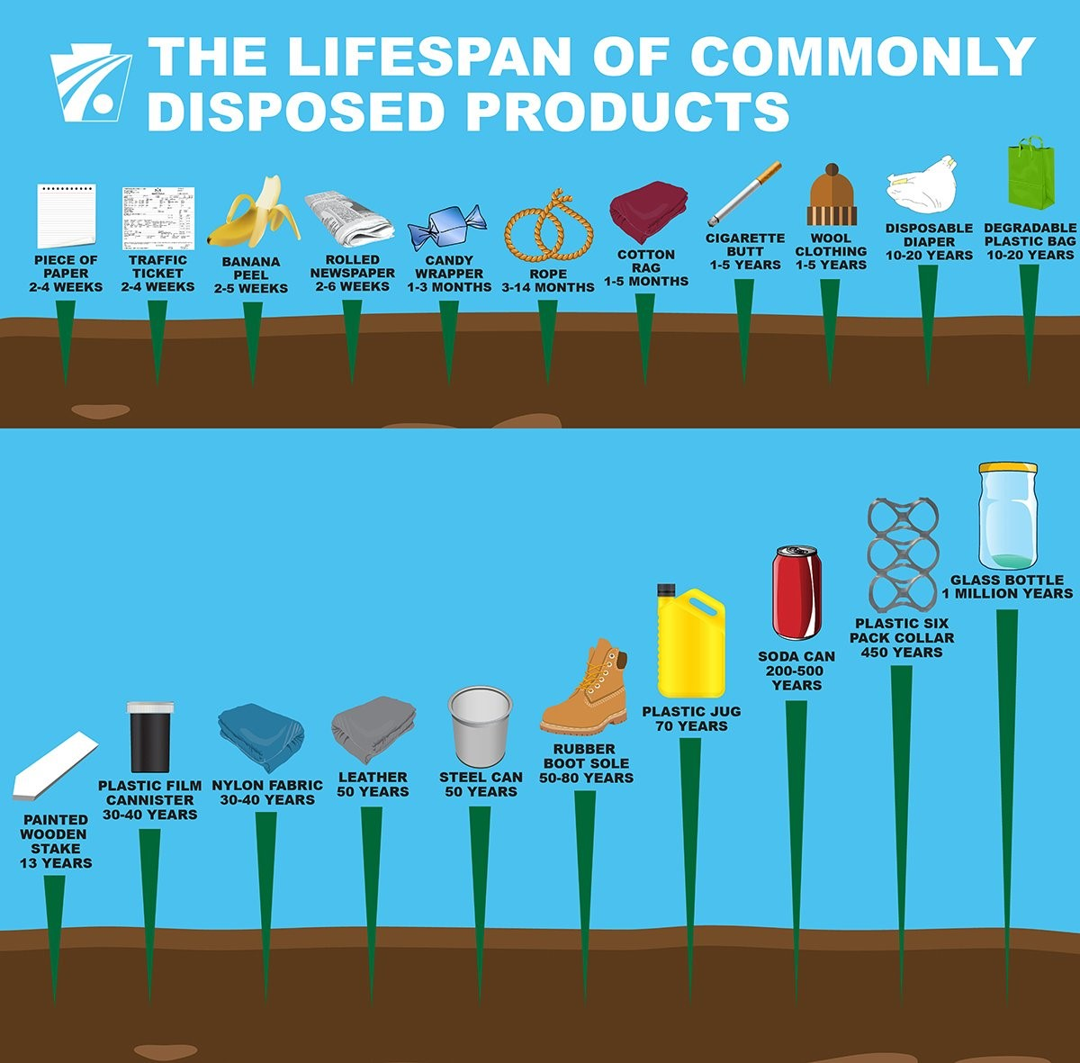
Spring Grove Borough Community Cleanup Week
Did you know the most common litter in streams is household trash?
Plastic bags, bottles, food wrappers, and many other items can quickly be transported by wind and/or surface water runoff during storm events (storm water).
Products such as cleaners, lawn fertilizers, and vehicle fluids are often inadvertently collected into storm drains. Organic material such as leaves, sticks, gravel and grass clippings also can be carried by storm water into the municipal system.
These materials often make their way into nearby waterways and eventually the ocean.
These are all forms of water pollution, and pose a great risk to aquatic life, water quality, and even our own health and safety.
During the Community Cleanup Week, join your neighbors and local businesses (while maintaining social distancing!) and help keep Spring Grove Borough Clean!
Submit photos and/or a simple description of what you and your household or business cleaned up on The Borough’s Facebook page. Use the hashtag #CleanSGB for a chance to be featured on our page.
Please remember to dispose of waste in an appropriate manner. We encourage the use of reusable or bio-degradable containers and/or bags! Together we can keep our community clean!
You can learn more about the impacts of litter on our waters and other ways to help here:
  https://www.epa.gov/trash-free-waters
Contact: manager@springgroveboro.com or 717-225-5791

Slide 13
MCM 3 –
Illicit Discharge Detection and Elimination
Federal regulations define an illicit discharge as “Any discharge to an MS4 that is not composed entirely of stormwater.” (With the exception of those discharges found on slide 6.)
  For more information, visit https://www3.epa.gov/npdes/pubs/fact2-5.pdf
Information regarding public illicit discharge reporting can be found on The Borough’s Stormwater page. If you witness an illicit discharge, please do one of the following:
    Call (717) 225-5791
    Fill Out SGB’s Illicit Discharge Form
      https://survey123.arcgis.com/share/da2d7f57dcd0487eab29cf2f52460581?portalUrl=https://bsgpa.maps.arcgis.com
The Borough screens 20% of all outfalls each year to prevent illicit discharges.
If you see something, say something!

Slide 14
MCM 4/5 –
Construction Site and
Post Construction
Stormwater Management
The Borough has an ordinance that requires the implementation and maintenance of Erosion and Sediment Control BMPs, including sanctions for non-compliance as applicable.
The Borough has an ordinance that requires the implementation and maintenance of post-construction stormwater management for new development and redevelopment projects, including sanctions for non-compliance.
https://ecode360.com/30595386

Slide 15
MCM 6 –
Pollution Prevention Plan and Good Housekeeping Procedures
The Borough is required to develop and implement an operation and maintenance program that includes a training component to prevent and reduce pollutant runoff from municipal operations.
Provide annual training aimed to eliminate the discharge of pollutants during municipal operations.
  Spill Prevention and Response
  Waste Disposal
  Routine Visual Inspections to Detect and Correct Potential Discharges At Properties Owned or Operated By The Permittee
Develop, implement, and maintain a good housekeeping plan for Borough-owned or operated properties where the following occurs.
  Vehicle or Heavy Equipment Maintenance
  Handling of:
    Deicers, fertilizers, pesticides, road maintenance materials, or hazardous materials.

Slide 16

Questions/Comments/
Want to Get Involved?
manager@springgroveboro.com
717-225-5791

